Slide 1
Periodontal MaintenanceTherapy
(PMT)
Omar Alkaradsheh

Slide 2
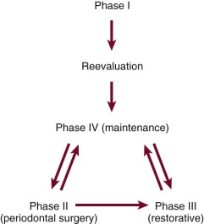
Correct sequence of periodontal treatment phases.
Notes:
The maintenance phase of periodontal treatment starts immediately after the completion of Phase I therapy While the patient is in the maintenance phase, the necessary surgical and restorative procedures are performed.
This ensures that all areas of the mouth retain the degree of health attained after Phase I therapy.

Slide 3
What we know:
The primary objective of periodontal treatment is to eliminate existing disease and to prevent future disease progression.
Pockets <5mm with no bleeding are less likely to show future disease progression and is considered a satisfactory outcome to periodontal treatment.
Following completion of initial nonsurgical therapy the re-evaluation appointment is crucial to determine the response to the treatment that has been carried out, at both the tooth level and the patient level, and to decide on any further treatment that will be required.

Slide 4

Re-evaluation not sooner than 6-8 weeks.
The comparison of clinical measurements before and after carrying out active treatment in order to measure treatment responses

Slide 5
Re-evaluation
“treated site”: < 5 mm and not bleeding.
2. “responding” or “partially treated” site: one that shows improvement (pocket depth reduction) from baseline but that is still 5 mm or greater or still bleeds on probing.
3. A “nonresponding site” one that has shown no improvement from baseline or shows deterioration

Slide 6
Reasons for poor response to treatment
Incorrect initial diagnosis
Inadequate plaque control
Inadequate subgingival debridement
Smoking
Other factors (systemic, genetic, microbiology)

Slide 7
Decision making for further treatment
Scaling & RD if obvious deposits remaining, persisting site is relatively shallow, or anterior sites.
Surgical approach is more likely to be chosen if or deeper sites, posterior sites, infrabony pockets or areas inaccessible to non-surgical tx.
Scaling & RD with antibiotics

Slide 9

Overview
What is Periodontal Maintenance Therapy (PMT)
Rationale and significance
‘Risk analysis’
SPT in daily practice
SPT and Implants
More Free PowerPoint Templates at SmileTemplates.com

Slide 10
PMT/Supportive Periodontal Therapy
“Supportive periodontal therapy should be directed towards limiting disease progression, identifying those sites that continue to break down and providing additional treatment when indicated”
American Academy of Periodontology 1998

Slide 11
Periodontal Maintenance Therapy
  Aims:
  To prevent or minimise recurrence of disease or progression in previously treated patients.
  To prevent/reduce incidence of tooth/implant loss.
  To increase likelihood of detecting and treating other oral conditions.

Slide 12
Rationale for PMT
Quantity & Quality of periodontal microbiota is altered following root debridement
( Listgarten et al. 1978).
Re-establishment of disease-associated pathogenic microbes at 8 weeks.
( Magnusson et al. 1984)
Attachment levels revert to pre-treatment baseline if no plaque control.
( Magnusson et al. 1984)

Slide 13
Rationale for PMT
Treated patients who do not return for regular recall are at 5.6 times greater risk for tooth loss than compliant patients.
(Checchi et al. 2002)
Another study showed that patients with inadequate SPT after successful regenerative therapy have a fifty-fold increase in risk of probing attachment loss compared with those who have regular recall visits.
(Cortellimi et al. 1994)

Slide 14
Rationale for PMT
Healing after non-surgical treatment is long J.E, weak and less resistant to inflammation?
(Stahl et al. 1967,1969)
OH Motivation:
  Patients tend to reduce their oral hygiene efforts between appointments.
  Knowing that their hygiene will be evaluated motivates them to perform better oral hygiene in anticipation of the appointment.

Slide 15
Rationale for SPT
Poor motivation and plaque control
Incomplete subgingival plaque removal
Healing by weak long Junctional Epithelium
Notes:
slow process compared with that of supragingival plaque. During this period (perhaps months), the subgingival plaque may not induce inflammatory reactions that can be discerned at the gingival margin. The clinical diagnosis may be further confused by the introduction of adequate supragingival plaque control because the inflammatory reactions caused by the plaque in the soft tissue wall of the pocket are not likely to be manifested clinically as gingivitis.
Thus inadequate subgingival plaque control can lead to continued loss of attachment, even without the presence of clinical gingival inflammation.

Slide 16
In conclusion
there is a sound scientific basis for recall maintenance because subgingival scaling alters the pocket microflora for variable but relatively long periods.

Slide 17
Clinical significance of SPT

Slide 18
Significance of SPT
3 studies:
Hirshfield & Wasserman 1978
Mcfall et al. 1982
Axelson & Lindhe 1981

Slide 19
Hirschfeld & Wasserman (1978)
600 patient
Private practice
Mean maintenance period = over 22 years
83% of well maintained patients lost fewer than 4 teeth
4% of patients lost 10 or more teeth

Slide 20
Axelsson and Lindhe (1981b)
Clinical trial
90 patients
Effect of absence of SPT over 6 years.
Initial examination followed by OHI, S+RD and 4 quadrant surgical treatment
For two months after surgery all patients received fortnightly S+P
Re-examined for baseline data.

Slide 21
Axelsson and Lindhe (1981b)
90 patients
1/3 2/3
Discharged to GDP Maintenance
(Non –Recall Group) (Recall Group)

Slide 22
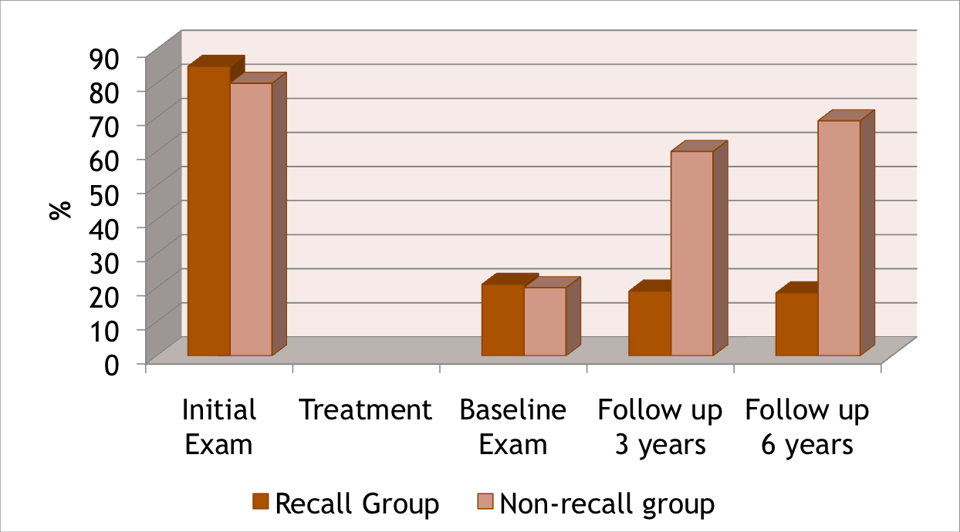
Plaque

Slide 23
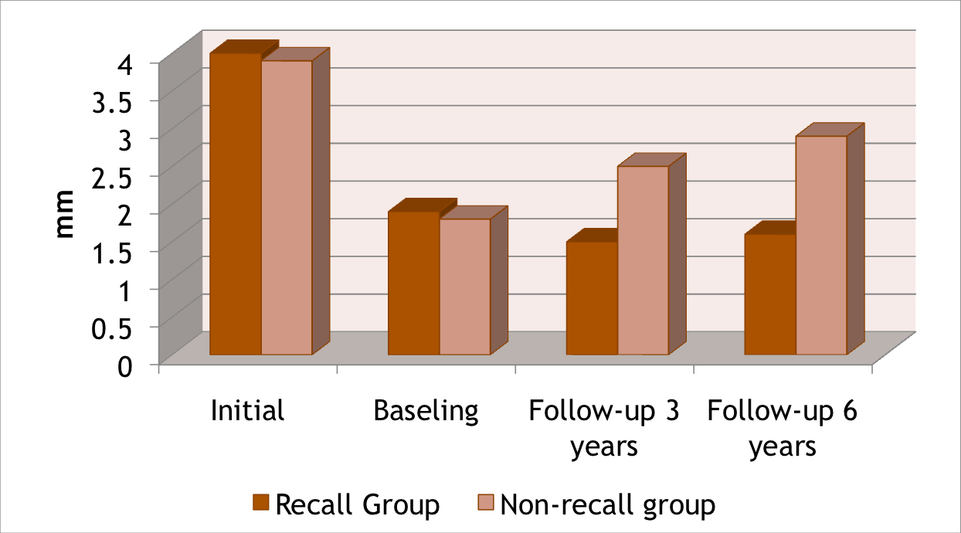
Probing Depth

Slide 24
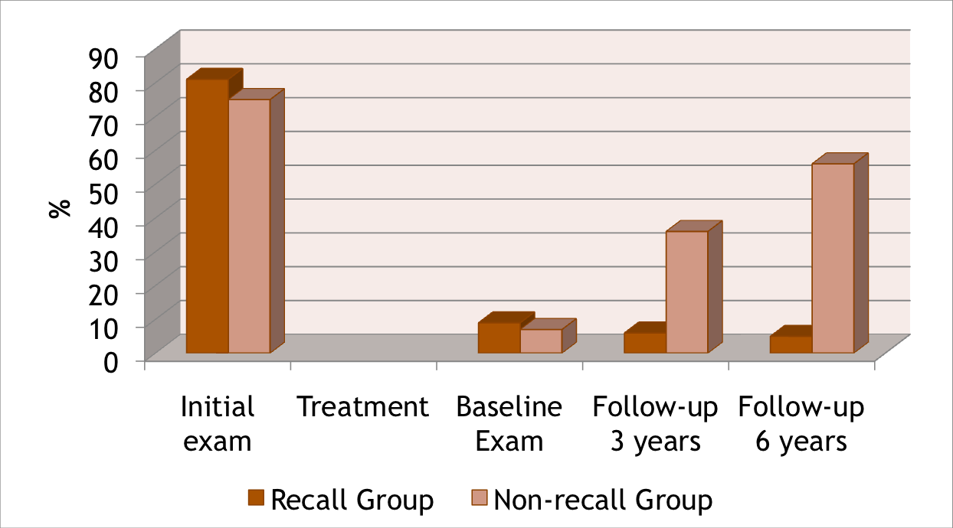
BoP

Slide 25
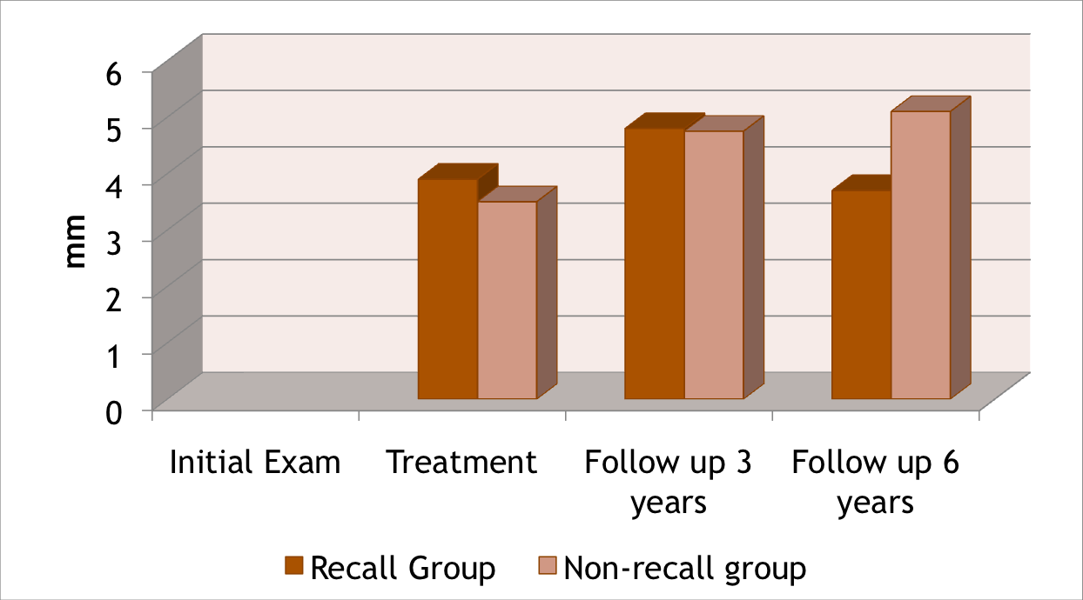
Attachment Level

Slide 26
Annual rate of tooth loss after SPT
Authors / year | Mean annual rate of tooth loss | Treatment/SPT provided?
Loe et al. 1986 | 0.1 - 0.3 | Untreated
Becker et al. 1979 | 0.61 0.11 <0.1 | Untreated Treated Treated/SPT
Hirschfeld & Wasserman 1978 | 0.03 | Treated/SPT
Wilson et al. 1987, | 0.06 | Treated/SPT

Slide 27
Conclusion
Longitudinal studies showed that the outcome of successful periodontal treatment can be maintained for years, which subsequently reduces the incidence of tooth loss.

Slide 28
SPT/PMT
Support the patient’s own efforts to control periodontal infections and to avoid reinfection.
Regular visits serve as a positive feedback mechanism between the patient and the therapist with the purpose of ensuring that patients have the opportunity to maintain their dentitions in a healthy status for the longest possible time.
Continuous diagnostic monitoring of the patient in order to intercept with adequate therapy and to optimize the therapeutic interventions tailored to the patient’s needs

Slide 29
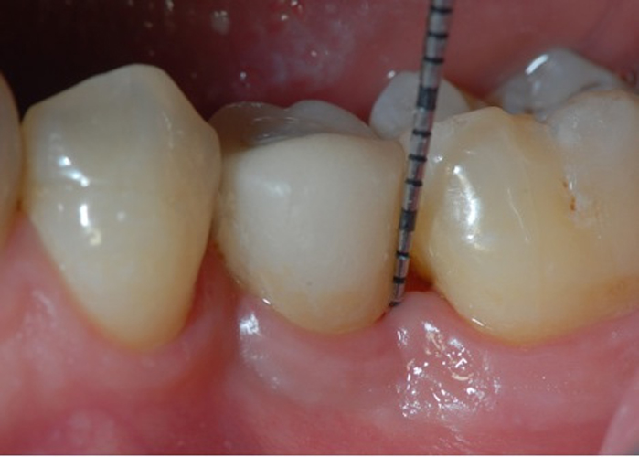
SPT in daily practice
What does it involve?
When does it start?
Who performs it?
How frequently?

Slide 30
Maintenance visit
Update PMH and PDH
Clinical examination
Radiographs if necessary
Assess OH
Treatment including OHI, SRP, restoration, Fluoride
Discussion
Arrange next appointment

Slide 31
Maintenance recall procedures
Lasts around One hour
Part I: Examination
Part II: Treatment
Part III: Discussion, reporting, schedule…

Slide 32
Part I: Examination (~14 min)
Patient greeting
Oral pathologic examination
Oral Hygiene status
Pocket depth changes
mobility/furcation changes
Occlusal changes
Restorative, prosthetic and implant status

Slide 33
Failing case can be recognized by the following:
Recurring inflammation
Increasing depth of sulci
Gradual increases in bone loss
Gradual increases in tooth mobility

Slide 34
Recurrence of periodontal disease
Inadequate or insufficient treatment (local factors, areas of difficult access).
Inadequate restorations placed after the periodontal treatment was completed.
Failure of the patient to return for periodic check-ups .( due to poor compliance or failure if dentist or staff to emphasize the need for periodic examinations).
Presence of some systemic diseases that may affect host resistance to previously acceptable levels of plaque.

Slide 35
Radiographic examination
Must be individualized.
Depends on the initial severity of the case and the findings at the recall visit .
These are compared with findings on previous radiographs to check :
  the bone height
  repair of osseous defects,
  signs of trauma from occlusion,
  periapical pathologic changes,
  caries.

Slide 36
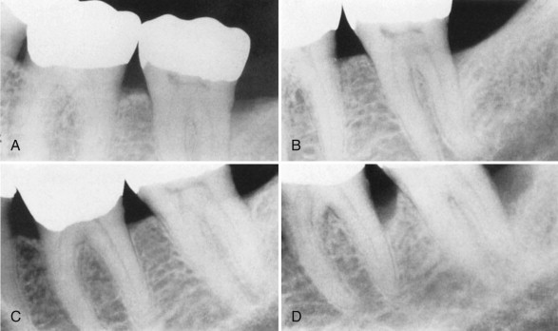
Notes:
This series of radiographs clearly shows the importance of maintenance therapy. A, Original radiograph of a 58-year-old male. Note the deep distal bone loss on tooth #18 and the moderate distal lesion of tooth #19. Surgical treatment included osseous grafting. B, Radiograph 14 months after surgical therapy. The patient had recall maintenance performed every 3 to 4 months. C, Appearance 3 years after surgery, with regular recalls every 3 to 4 months. D, Appearance after 2 years without recalls (7 years after surgery). Note the progression of the disease on the distal surfaces of teeth #18 and #19.

Slide 37
Radiographic Examination of Recall Patients for Supportive Periodontal Treatment
Patient Condition/Situation | Type of Examination
Clinical caries or high-risk factors for caries. | Posterior bite-wing examination at 12- to 18-month intervals.
Clinical caries and no high-risk factors for caries. | Posterior bite-wing examination at 24- to 36-month intervals.
Periodontal disease not under good control. | Periapical and/or vertical bite-wing radiographs of problem areas every 12 to 24 months; full-mouth series every 3 to 5 years.
History of periodontal treatment with disease under good control. | Bite-wing examination every 24 to 36 months; full-mouth series every 5 years.

Slide 38
Identifying disease progression
At present, the best way of determining areas that are losing attachment is by Comparison of sequential probing measurements gives the most accurate indication of the rate of loss of attachment
Patients whose disease is clearly refractory are candidates for bacterial culturing and antibiotic therapy in conjunction with additional mechanical therapy.
New methods??
Notes:
Comparison of sequential probing measurements gives the most accurate indication of the rate of loss of attachment

Slide 39
Part II Treatment (~36 min)
  Oral Hygiene reinforcement
  Scaling
  Polishing
  Root planing
  Chemical irrigation or site-specific antimicrobial placement
  Restorations
  Fluoride application

Slide 40
Part III: Report, Clean-up, and Scheduling (~10 min)
  Write report in chart.
  Discuss report with patient
  Clean and disinfect operatory
  Schedule next recall visit
  Schedule further periodontal treatment
  Schedule or refer for restorative or prosthetic treatment

Slide 41
SPT in daily practice
What does it involve?
When does it start?
Who performs it?
How frequently?

Slide 42
When?
SPT should start when the initial/corrective phase of therapy has been completed
SPT is ongoing for the life of the patient, while there are teeth or implants present

Slide 43
SPT in daily practice
What does it involve?
When does it start?
Who performs it?
How frequently?

Slide 44
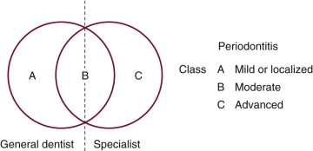
Who should provide SPT?
Notes:
he most important factors in the decision are the extent and location of the periodontal deterioration.

Slide 45
SPT in daily practice
What does it involve?
When does it start?
Who performs it?
How frequently?

Slide 46
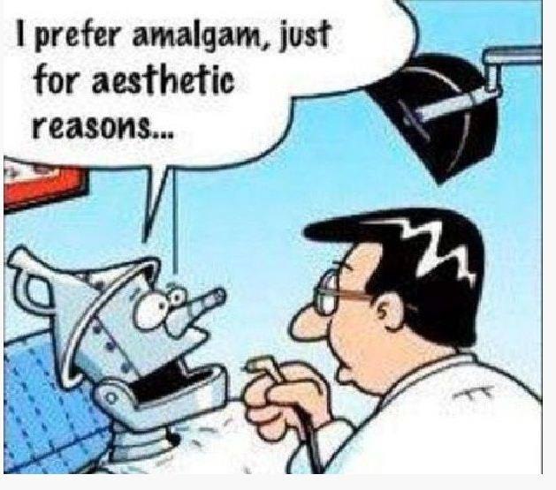
Frequency
The interval between visits is initially set at 3 months .
Tailored to the individual needs of each patient.
Decided by the clinician based on the
  History of disease progression
  Patients medical history
  Compliance with oral hygiene instructions
  Disease extent and severity.

Slide 47
Frequency
The recall interval for first-year patients should not be longer than 3 months.
  educating the patient & reinforcing oral hygiene may take several months
  to evaluate accurately the results of some periodontal surgical procedures
  some areas may have to be re-treated because the results may not be optimal.
  the first-year patient often has etiologic factors that may have been overlooked and may be more amenable to treatment at this early stage.
SPT plan is continuously reviewed and updated

Slide 48
BUT…
Not all patients are at equal risk of developing disease progression

Slide 49
Risk assessment
Risk factors increase probability of disease.
Risk assessment is essential for identifying susceptible individuals and tailor treatment.
Multi-factorial disease

Slide 50
Risk assessment
Subject level
Tooth level
Site level

Slide 51
Subject risk factors
% sites bleeding on probing
Prevalence of sites with PPD>4mm
Loss of teeth (excluding third molars)
Bone loss/age
Systemic and genetic conditions
Environmental factors e.g. smoking

Slide 52
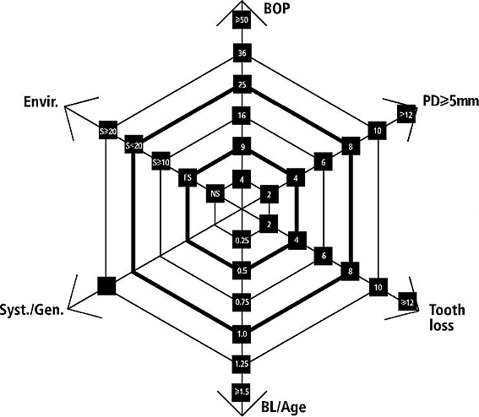
Risk Analysis
Lang & Tonetti, 2008

Slide 53
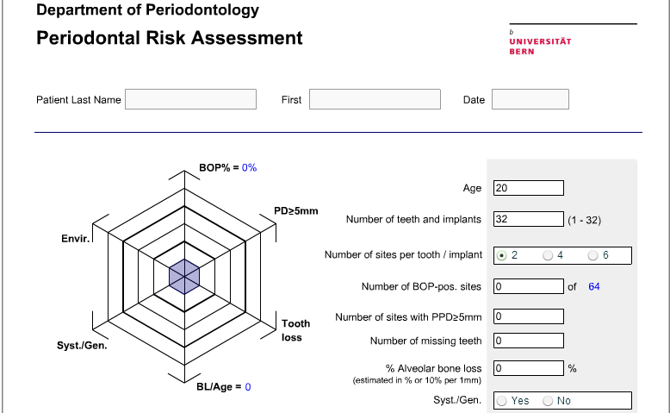
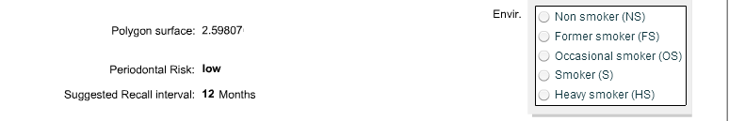
http://www.perio-tools.com/pra/en/

Slide 54
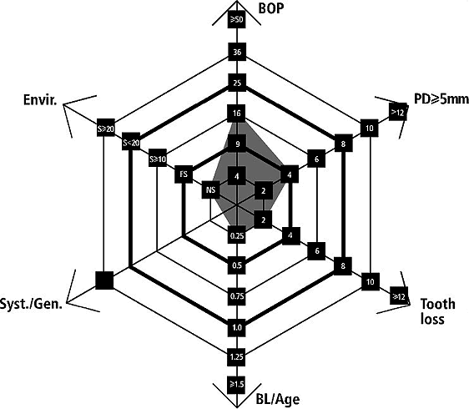

Slide 55
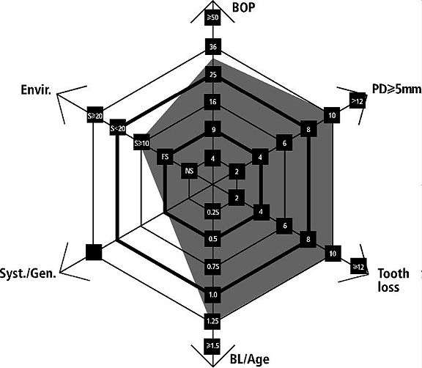

Slide 56
Oral Hygiene
Full-mouth assessment of the bacterial load have a pivotal impact in the determination of the risk for disease recurrence.
In a clinical set-up, a plaque control record of 20–40% might be tolerable by most patients.
Full mouth plaque score has to be related to the host response of the patient, i.e. compared to inflammatory parameters.

Slide 57
Compliance
It is essential that patient is aware prior to initial treatment that they will be required to adhere to maintenance programme long term (cost and time commitment).
28% patients did not attend their first SPT visit.
(Ojima et al. 2001)
59% patients <30years old were non-compliant.
(Novaes & Novaes, 2001)
Non-compliance resulted in mean annual tooth loss similar to no treatment – 0.32-0.38. (
Kocher et al. 2000)

Slide 58
Compliance
Authors/ yeart | % of compliant patients | Maintenance period
Wilson et al. 1983 | 16% compliant 34% non compliant 49% erratic compliance | 8 years
Demitriou et al. 1995 | 27% | 14 years
Konig et al. 2001 | 25% | 10 years

Slide 59
Tooth level
Position within arch
Degree of furcation involvement
Iatrogenic factors – overhanging restorations
Residual periodontal support
Mobility

Slide 60
Site level
Bleeding on probing
PPD/attachment loss
Suppuration

Slide 61
Multi-level Risk Assessment
To schedule patients for supportive periodontal therapy on the basis of an individual risk evaluation for recurrence of disease has been demonstrated to be cost effective.
(Axelsson & Lindhe 1981a,b; Axelsson et al.1991)
The determination of such risk level would thus prevent undertreatment, and also excessive overtreatment, during SPT.
(Brägger et al. 1992).

Slide 62
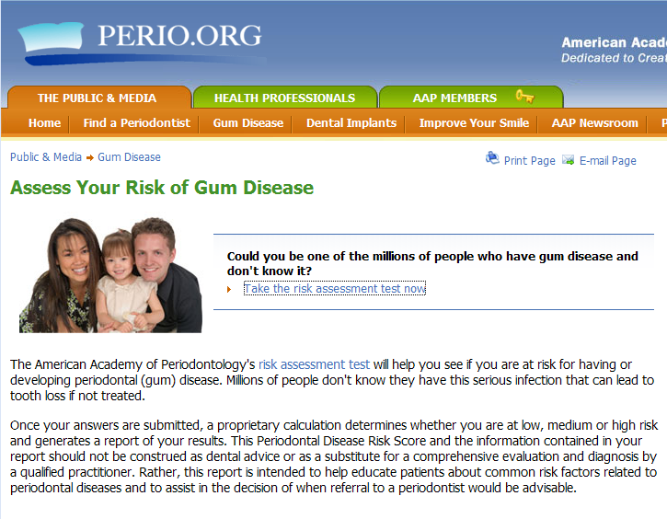

Slide 63
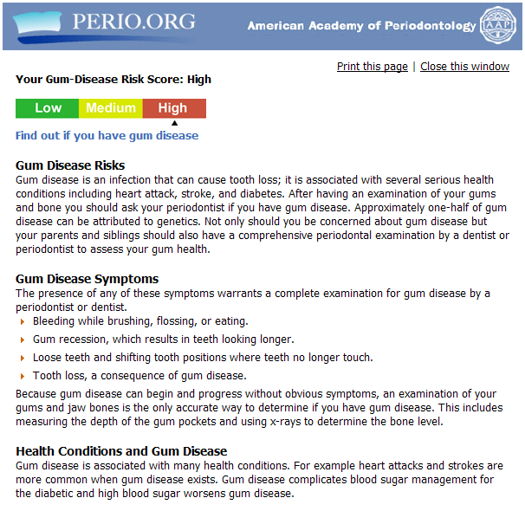
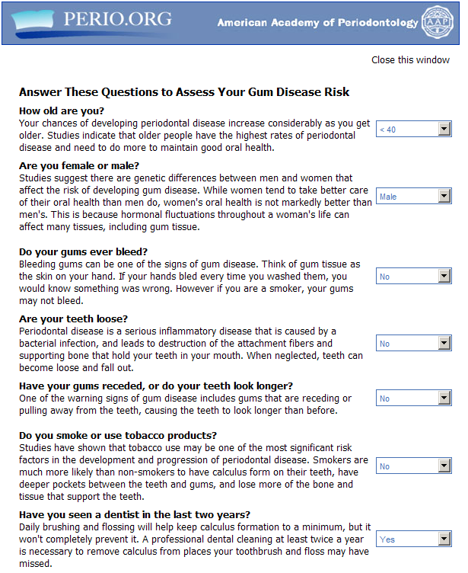
Risk assessment

Slide 64
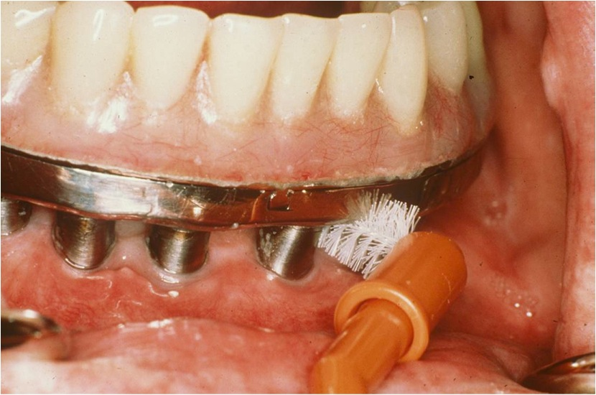
Implant Supportive Care

Slide 65
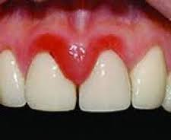
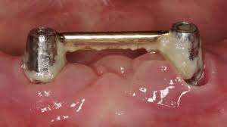
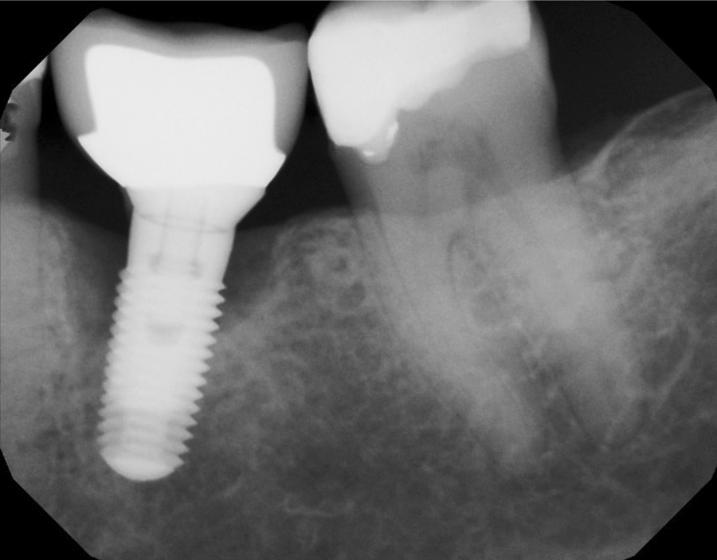
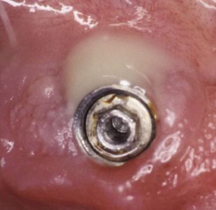

Slide 66
Implant maintenance
Plaque control at implants is as important as at natural teeth.
Hypothesized that routine instrumentation could roughen surface, enhancing potential for plaque accumulation.

Slide 67
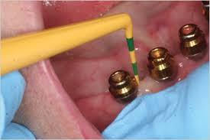
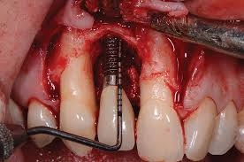

Slide 68
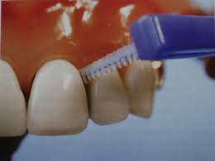

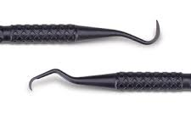
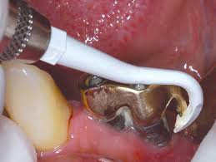
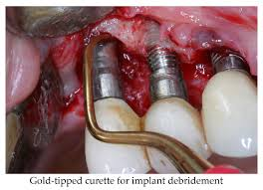

Slide 69
In general, procedures for maintenance of patients with implants are similar to those for patients with natural teeth, with the following three differences:
  Special instrumentation that will not scratch the implants are used for calculus removal on the implants.
  Acidic fluoride prophylactic agents are avoided.
  Nonabrasive prophy pastes are used.

Slide 70
Conclusions
SPT essential part of periodontal treatment
Patient must be made aware of importance and commitment required
Bulk of SPT provided in general practice
Must be tailored to each patient

Slide 71

Thank you

